Slide 1
Impact of ICT in Education
Presented by
Shelke Bharat Abhimanyu
Asst. Professor
Dept. of Computer Science
S C S College, Omerga

Slide 2
Contents
ICT in Day to Day Life
ICT Tools
Necessity of ICT
Impact of ICT in Education
Scope & Limitations
Conclusion
About ICT

Slide 3
About ICT
Information Communication Technology
Definition –
Information and communication technologies (ICT) are simply technologies arising from scientific and technological progress in computer sciences, electronics and telecommunications.
They enable us to process, store, retrieve and broadcast valuable information in text, sound and video form.
ICT is a technology for successful communication between sender and receiver.
ICT in education has lead to changes the teaching approaches in traditional education to e-learning education.

Slide 4
Cont.. About ICT
The ministry of education recently developed a strategy for the implementation of the national ICT policy in basic education.
National Mission of ICT Education announced 500 hundred cr. Rupees to implement ICT in Education & government offices .
The strategy includes mention of training in ICT for teachers and school directors and integration of ICT into the curriculum.

Slide 5
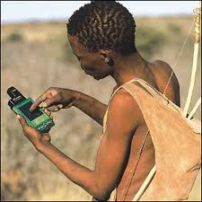
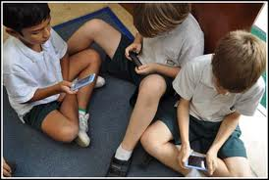
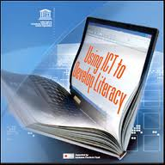
ICT in Day to Day life
Media Literacy
Information Literacy
Technology Literacy

Slide 6
Banking
ICT in Day to Day life

Slide 7
Paying for goods
ICT in Day to Day life

Slide 8
Photography
ICT in Day to Day life

Slide 9
Printing
ICT in Day to Day life

Slide 10
Personal Communication
ICT in Day to Day life

Slide 11
Information Search
ICT in Day to Day life

Slide 12
Education
Needs Change ?
Welcome to ICT
Traditional Teaching & Learning
ICT based Teaching & Learning

Slide 13
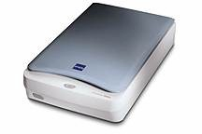
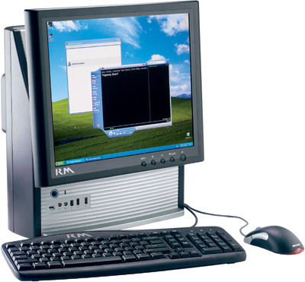
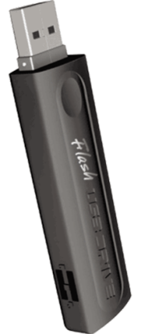
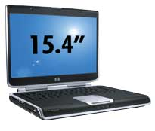
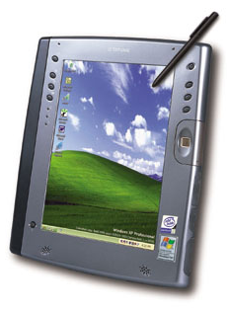
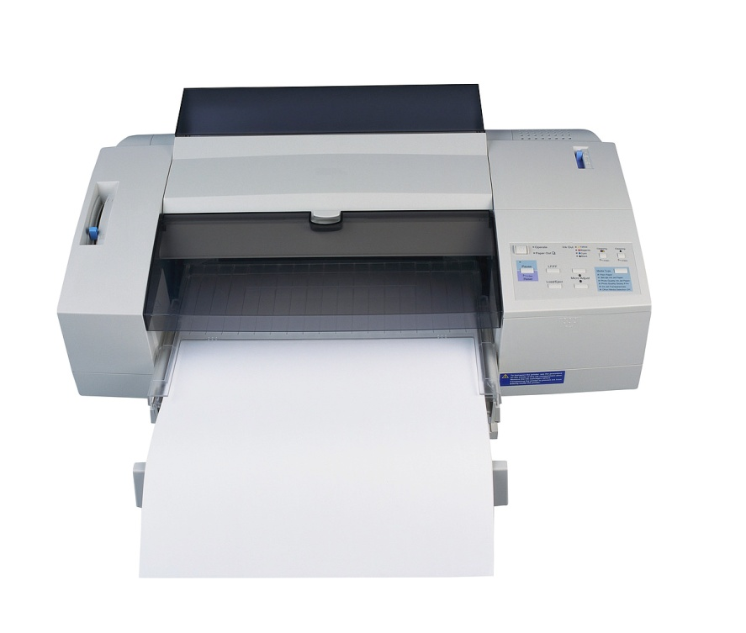
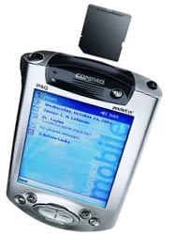
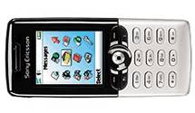
ICT Tools
Scanner
Pen Drive
Laptop
Desktop Computer
Digital Camera
Printer
Card Reader
Mobile with Stylus

Slide 14
ICT Tools
Image Scanners and Optical Character Recognition –
Image scanners convert any printed image/document into electronic form readable by computer machine.
OMR
MICR
OCR
Scanner
Optical Mark Recognizer
Magnetic Ink Character Recognizer
Optical character Recognizer

Slide 15
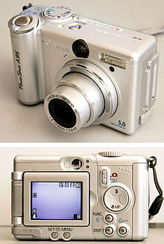
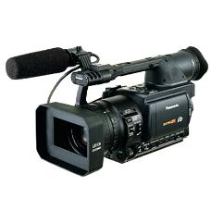
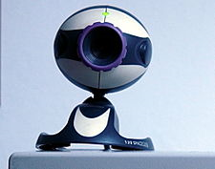
Cont... ICT Tools
Digital Camera
It works like PC Video Cameras, except digital camera is portable, handheld device that capture still images.
Normal film cameras capture images on a specially coated film and digital cameras capture images electronically.
The digital camera digitizes the image, compresses it, and sores it on special memory card.
The user can then copy the information to a PC, where the image can be edited, copied, printed, embedded in a document or transmitted to another user.
Graphic designers can edit and enhance digital photographs using photo-editing software.

Slide 16
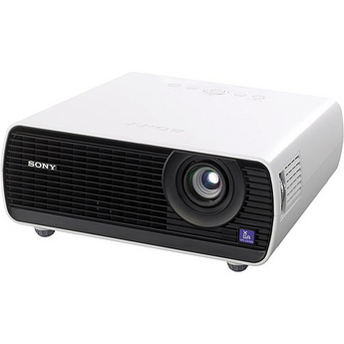
Cont... ICT Tools
Data Projectors –
To get presentations on big screen LCD Projectors or data projectors are used.
A data projector plugs into one of the computer’s ports and then projects video output onto the external surface.
These devices can display 16 million colour combinations at high resolution. Many projectors work in still-video mode or full-video animation mode.
Most projectors use LCD Technology to create images.
Price - > 35,000 rupees.

Slide 17
Necessity of ICT
The teachers use ICT for documentation, to access teaching and learning material for their classroom use.
ICT knowledge resources are available on Internet.
Teachers will downloads the teaching materials from online libraries.
Teachers will use ICT to prepare lessons.
ICT will changed textbook-based teaching to web-based community.
ICT is useful to students to obtain information, do research, learn and understand better, and communicate.

Slide 18
Impact of ICT in Education
The use of ICT in instruction brings about changes in teacher roles
Changes in Teacher Roles
A shift from |  | To
knowledge transmitter primary source of information teacher controlling Directing all aspects of learning |  | learning facilitator, collaborator, coach, knowledge navigator Teacher giving students more options and responsibilities for their own learning
The use of ICT brings about changes in student roles
Changes in Student Roles
A shift from |  | To
passive recipient of information reproducing knowledge learning as a solitary activity |  | active participant in the learning process producing knowledge

Slide 19
Impact of ICT in Education
Identifying Learning Styles and Using Strengths to help Weaknesses.
ICT supports teaching and learning across the curriculum.
Good practice in ICT will support all learners, encourage independence and individual progress.
ICT offers opportunities for differing learning styles
ICT can support the production of well presented, high quality outcomes
Use of speech and sound to support visual strengths
Encouragement of handling of objects alongside looking and listening
Use of images to support auditory strengths

Slide 20
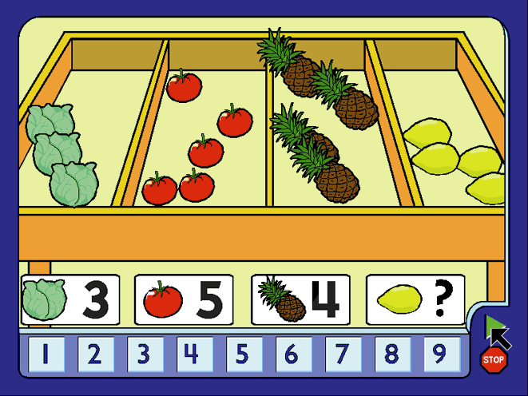
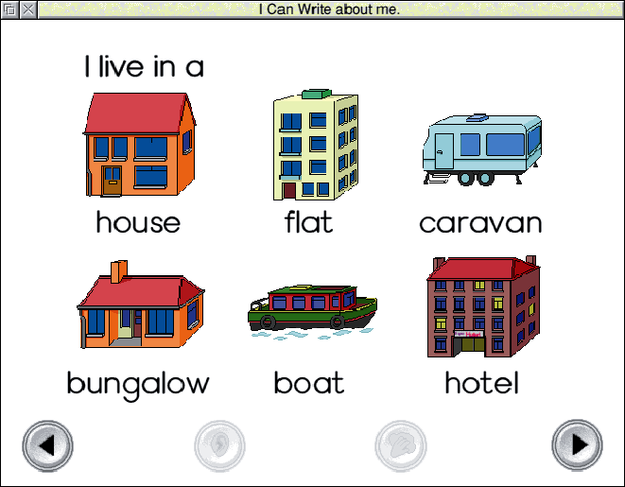
ICT supports teaching and learning across the curriculum

Slide 21
Scope
Teachers
Preparing teaching materials
Participate in online forums and online conferences
Prepares a blogs for communication platform to interact with students
Online Teaching with the help of Video conference
Students
Interactive learning experience
Use ICT as reference tool. (Project, Literature survey)
Use ICT to tool collect and process data.
Administrators
For administrative purposes
Developing Digital Institute
Improve the quality in Education

Slide 22
Limitations
Most of the classrooms were built without the idea of ICT
Most classrooms do not have electrical installations
Computer un- literary
Negative attitude of new technology
No any Government budget

Slide 23
Conclusions
Proper teacher training
Awareness of ICT technology in society
Govt. must be provide ICT Instruments
ICT as a compulsory subject at school level
ICT will be create global educational environment

Slide 24
Thank You

